Slide 1
Memory Network
Chenrui Li

Slide 2
Related papers
J. Weston, S. Chopra, A. Bordes. Memory Networks. ICLR 2015
S. Sukhbaatar, A. Szlam, J. Weston, R. Fergus. End-To-End Memory Networks. NIPS 2015

Slide 3
Motivation
Long-term memory is required to solve the machine understanding task.

Slide 4
Example
Memory
antoine go kitchen
antoine get milk
antoine go office
antoine drop milk
antoine go bathroom
Q1:where is milk?
A1:office
s1
s2
s3
s4
s5
(dynamic) knowledge base

Slide 5
MemNN/RNN/LSTM
Memory
Memory
RNN
LSTM

Slide 6
MemNN/RNN/LSTM
OUTPUT
RNN/LSTM
MemNN
RNN/LSTM
INPUT

Slide 7
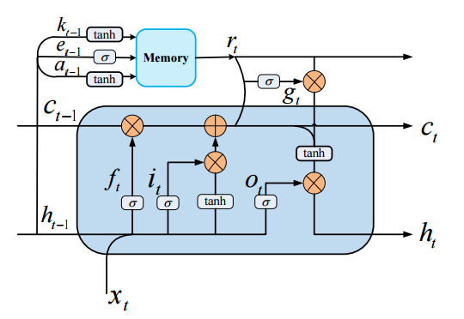
External Mem/Internal Mem
External Mem.
Controller
Deep Multi-Task Learning with Shared Memory
Pengfei Liu, Xipeng Qiu and Xuanjing Huang

Slide 8
Memory Network
A memory network consists of a memory m and four components I,G,O and R.
I: (input feature map) this converts incoming data to the internal feature representation.
G: (generalization) this updates memories given new input.
O: this produces new output (in feature representation space) given the memories.
R: (response) converts output O into a response seen by the outside world.
This process is applied both train and test time, only difference is model parameter I, G, O and R are not update during test time.

Slide 9
Memory Network
I Component:
embedding sum
RNN encode
LSTM encode
.
.
.
vector representation
encode
parsing
coreference-resolution
.
.
.
pre-processing
Text

Slide 10
Memory Network
G Component:
The simplest form of G is to store I(x) in a “slot” in the memory:
H(x) is a function selecting the slot.
m1
m2
m3
...
mn
x1
x2
x3
xn

Slide 11
Memory Network
(x,m1,m2)
O Component:
It is responsible for reading from memory and performing inference.
e.g.find the k best matches with input
Memory
(x,m1)
Memory
Input X

Slide 12
Memory Network
<hop1>
Match (Where is the football ?, John picked up the football)
<hop2>
Match( [Where is the football ?, John picked up the football],John is in the playground)
John is in the playground
John picked up the football
Q:where is the football?

Slide 13
Memory Network
R Component:
R produces the final result.
answer
RNN/LSTM
output

Slide 14
Basic Model-Output
Find the most relevant memory 1 (hop 1):
and are matching functions. They have the same form:
is the feature map function.
U can be trained during training.
Find the most relevant memory 2 (hop 2):
Find the final answer:

Slide 15
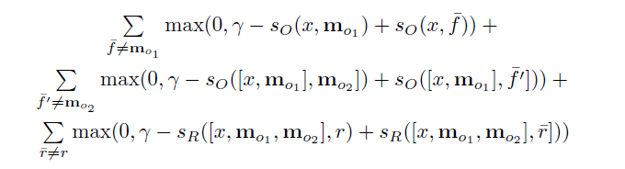
Training
Minimize the object function(k=2):
Training is performed with a margin ranking and stochasic gradient descent(SGD).
and are labeled.

Slide 16
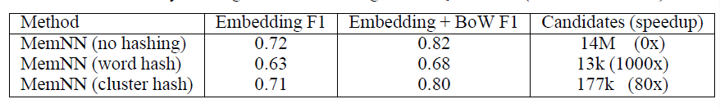
Tricks
Efficient Memory Via Hashing
Hashing word
Memory will be considered if only share at least one word
Clustering word embedding
Run K-means to cluster word vectors U, given K buckets
Hash a given sentence into all the buckets that it’s individual words fells into.

Slide 17
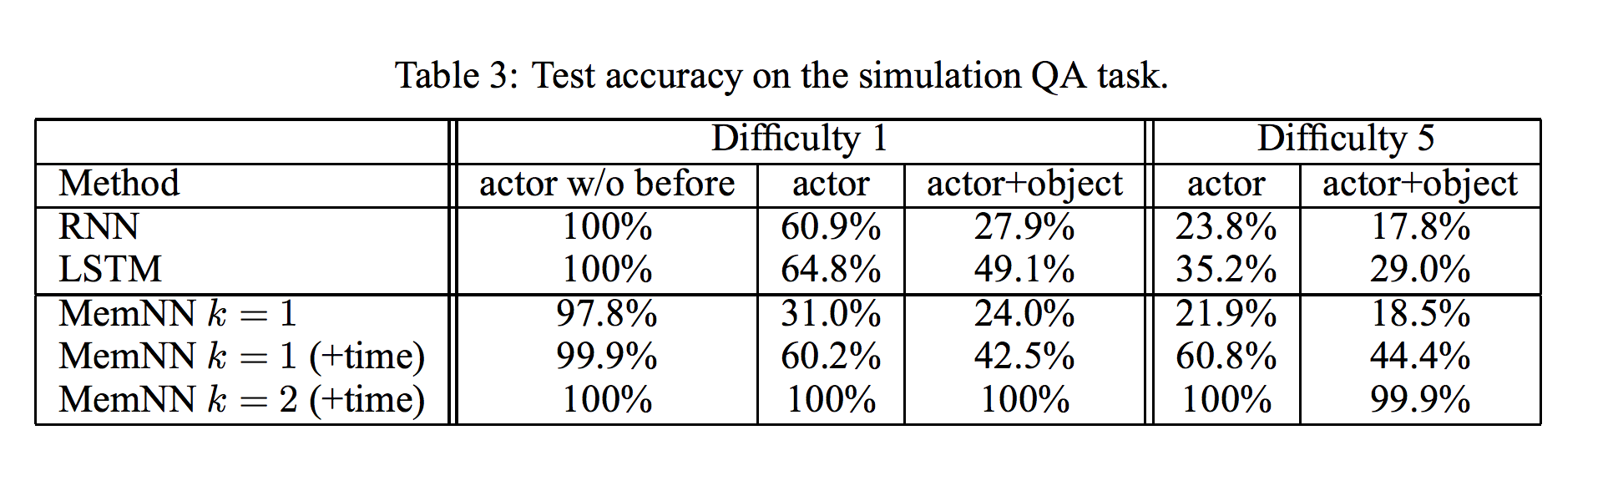
bAbi Experiment
10k sentences. (Actor: only ask questions about actors.)
• Difficulty: how many sentences in the past when entity mentioned.
• Fully supervised (supporting sentences are labeled).
• Compare RNN (no supervision) and MemNN hops k = 1 or 2.

Slide 18
Shortcomings of Existing Model
They model sentences with a bag of words so are likely to fail on tasks such as the 2-argument and 3-argument relation problems.
They perform only two max operations (k = 2) so they cannot handle questions involving more than two supporting facts
Unless a RNN is employed in the R module, they are unable to provide multiple answers in the standard setting. e.g.list and path finding tasks.

Slide 19
Memory Network
Problem of Memory Network:
not easy to train via back propagation
required supervision at each layer of the network.

Slide 20
End-to-end Memory Network
1.RNN+large external memory
2.Be considered as a continuous form of MemNN.
3.Can be trained end-to-end.
4.Be applicable to more tasks.

Slide 21
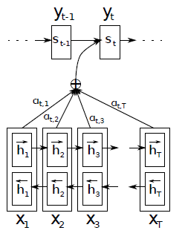
Selective Attention
Assign different weights to different input
Conventional model
SUM
1
1
1
Input

Slide 22
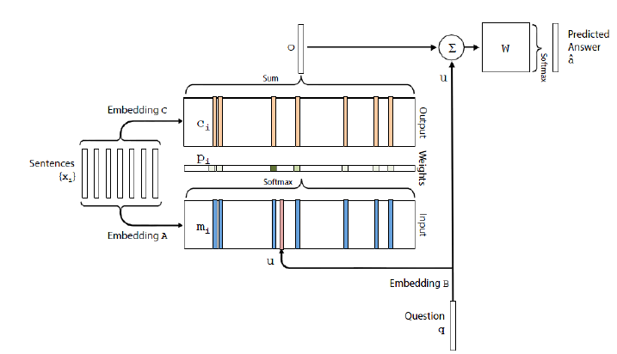
Single-layer
Only implements a single hop operation.
Embedding parameter: A,B,C,W
Embedding representation:
Input memory representation:
*MemNN:hardmax

Slide 23
Single-layer
Output memory representation:
Generating the final prediction:

Slide 24
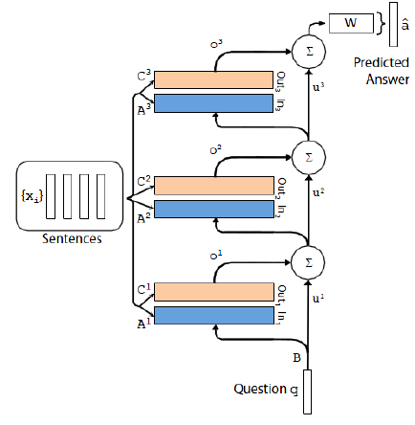
Multiple-layers
ht+1
Xt+1
ht
Xt
ht-1
Xt-1

Slide 25
Multiple-layers
·
·Each layer has its own embedding matrices Ak,Ck, used to embed the inputs {xi}.
·the output of the top memory layer:

Slide 26
Multiple-layers
Weight type
1: Adjacent:
A^{k+1} = C^{k}
W^{T} = C^{K} (final output embedding)
B = A¹
2: Layer-Wise
A¹ = A² = …
C¹ = C² = …
u^{k+1} = Hu^{k} + o^{k}

Slide 27
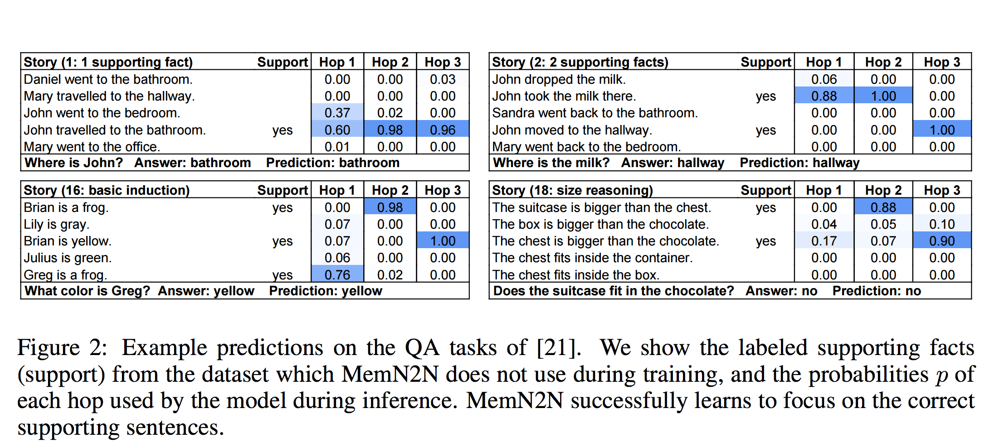
Experiment-Synthetic QA

Slide 28
Own ideas
1.
2.match function
F(Di,Q)
memory
F(Di,Q)
softmax
memory
F(Di,Q)
Question
Question

Slide 29
3. Implementing the convolution operation for memory

Slide 30
Question?

